Slide 1
Computer Systems Architecture

Slide 2
Memory

Slide 3
Motivation
In real life memory is finite
Fast memory is expensive
Memory access is critical to overall performance
Lots of research on processor-cache interface
Main and virtual memory organization is yet another performance bottleneck

Slide 4
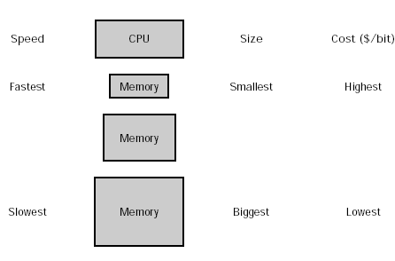
Memory Hierarchy
Cache Static RAM
5-25 ns access time
Cost/MByte highest
Hard Disk
10-20 million ns
Cost/MByte low
Main Memory Dynamic RAM
60-120 ns access time
Cost/MByte high

Slide 5
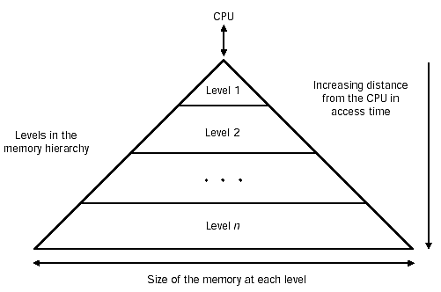
Memory Hierarchy

Slide 6
Goals of Hierarchical Memory Design
Achieve an average memory access time that is almost as fast as the fastest memory level
Achieve an average price per bit that is as low as the lowest memory level
Use lessons learned from locality principle for both data and instructions
Achieve overall high and cost-effective performance

Slide 7
Memory Strategies
Make entire memory fast
Separate concerns: segregate instruction memory from data memory if dual-port memory is available
Make memory ports wide so that can access larger chunks
De-randomize memory access by clever programming or compilation
Encourage prefetching to the largest extent possible
Create a memory hierarchy to keep hot items in fast memory
Use principle of locality

Slide 8
Key Idea
Make the common case fast
Common → Principle of locality
Fast → Smaller is faster

Slide 9
Principle of Locality
Temporal locality
Locality in time
If a datum has been recently referenced, it is likely to be referenced again
Spatial locality
Locality in space
When a datum is referenced, neighboring data are likely to be referenced soon

Slide 10
Basic Terminology
Cache -- name given to the first level of memory seen from the CPU
Miss rate -- fraction of memory accesses that are not in the cache
Miss penalty -- additional clock cycles needed to service a cache miss
Hit time -- time to hit in the cache
Block -- smallest unit of data that can be accessed from main memory

Slide 11
Cache Performance Review
CPU execution time = (CPU clock cycles + Memory Stall cycles) x Clock cycle time
Memory stall cycles = Number of misses x Miss penalty

Slide 12
Example
CPI=1 when all memory accesses hit in cache
Loads and stores are 50% of the instructions
Miss penalty is 25 clock cycles
Miss rate is 2 %

Slide 13
The Cache
Main Memory Fragment
1000
5600
1004
3223
Cache
1008
23
1012
1122
1000
5600
1016
0
1016
0
1020
32324
1048
2447
1024
845
1028
43
1028
43
1032
976
1036
77554
4 Most recently accessed Memory locations (exploits temporal locality)
1040
433
1044
7785
1048
2447
1052
775
Issues:
How do we know what’s in the cache?
What if the cache is full?
1056
433

Slide 14
Basic Cache Questions
Block placement
Where can a block be placed in the cache?
Block Identification
How is a block found in the cache?
Block replacement
Which block should be replaced on a miss?
Write strategy
What happens on a write?

Slide 15
Q1: Block Placement
Fully associative
arbitrary location in cache
Direct mapped
each block has a unique location in the cache
Block_index = Block_address mod Number_of_blocks
Set associative
arbitrary location within unique set
Set_index = Block_address mod Number_of_sets
Number_of_sets = Number_of_blocks/ Number_of_blocks_per_set

Slide 16
Direct Mapping
6-bit Address
Main Memory
00 00 00
5600
00 01 00
3223
Cache
00 10 00
23
00 11 00
1122
Valid
01 00 00
0
Index
Tag
Data
01 01 00
32324
00
Y
00
5600
01 10 00
845
01
Y
11
775
01 11 00
43
10
Y
01
845
10 00 00
976
11
N
00
33234
10 01 00
77554
10 10 00
433
In a direct-mapped cache:
-Each memory address corresponds to one location in the cache
-There are many different
memory locations for each cache entry (four in this case)
10 11 00
7785
11 00 00
2447
11 01 00
775
11 10 00
433
11 11 00
3649
Tag
Index
Always zero (words)

Slide 17
Hits and Misses
When the CPU reads from memory:
Calculate the index and tag
Is the data in the cache? Yes – a hit, you’re done!
Data not in cache? This is a miss.
Read the word from memory, give it to the CPU.
Update the cache so we won’t miss again. Write the data and tag for this memory location to the cache. (Exploits temporal locality)
The hit rate and miss rate are the fraction of memory accesses that are hits and misses
Typically, hit rates are around 95%
Many times instructions and data are considered separately when calculating hit/miss rates

